Slide 1
Java Data Types

Slide 2
Java Data Types
Data types are divided into two groups:
Primitive data types - includes byte, short, int, long, float, double, boolean and char
Non-primitive data types - such as String, Arrays and Classes

Slide 3
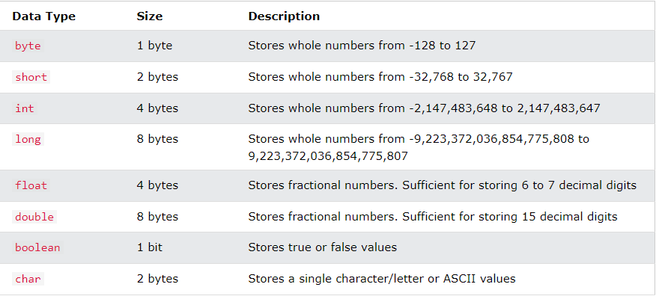
There are eight primitive data types in Java:

Slide 4
Java Numbers
Primitive number types are divided into two groups:
Integer types stores whole numbers, positive or negative (such as 123 or -456), without decimals. Valid types are byte, short, int and long. Which type you should use, depends on the numeric value.
Floating point types represents numbers with a fractional part, containing one or more decimals. There are two types: float and double.

Slide 5
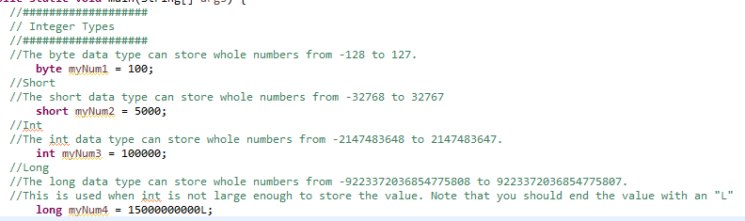
Integer Types

Slide 6
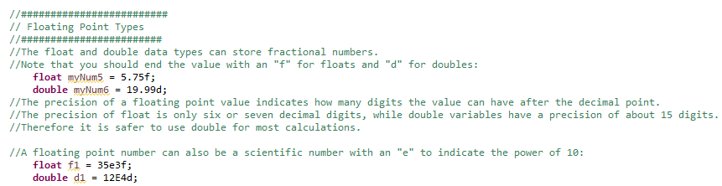
Floating Point Types

Slide 7

Boolean Types

Slide 8
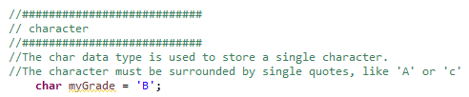
Character

Slide 9

Strings

